Slide 1


HIGH CLOUD AIRLINES
PROJECT
Group 2
Glavin S
Madan N
Tarun Pandey
Sruthy Premanand
Chethan M
Ishta

Slide 2

INDEX
1
KPI’s EXPLANATION
2
EXCEL DASHBOARD
3
POWER BI DASHBOARD
4
TABLEAU DASHBOARD
5
SQL QUERIES
6
KEY INSIGHTS
7
RECOMMENDATIONS
8
CHALLENGES AND OVERCOME

Slide 3
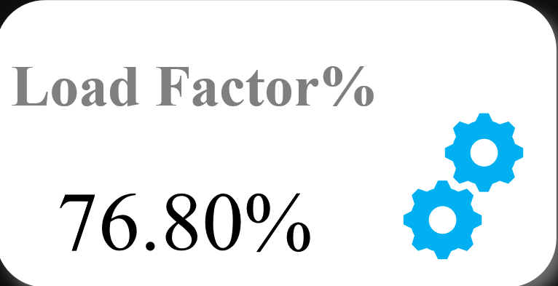
Load Factor %
KPI
Load Factor represents how efficiently airline seating capacity is utilized.
It shows the percentage of available seats that are actually filled by passengers.
Key Insights
Load Factor for the airlines is 76.80%.
Industry benchmark typically ranges between 70%–85%.
Indicates healthy seat utilization

Slide 4

Total Flights Operated
KPI
Helps assess airline network size and activity.
Used to analyze fuel planning and crew scheduling.
Key Insights
Airline has almost 2.80 million flights.
Shows wide route network.

Slide 5
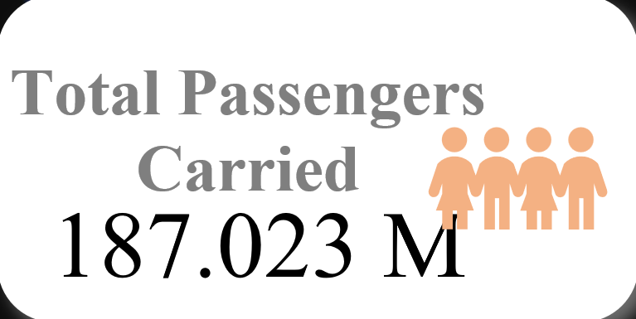
Total Passengers Carried
KPI
Reflects customer demand
Used to assess market reach and airline popularity
Strongly linked with revenue generation
Key Insights
Airline has carried almost 187.02 million passengers
Indicates strong customer base and consistent demand

Slide 6
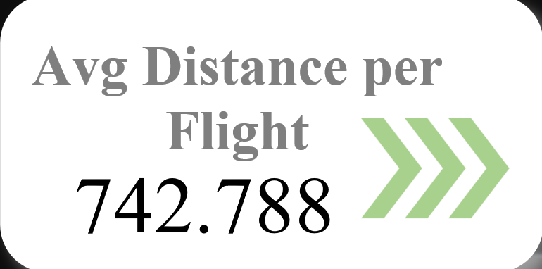
Average Distance per Flight
KPI
Distinguishes short-haul vs long-haul operations
Influences fuel consumption, aircraft type, and crew requirements
Key Insights
Average distance per flight for the airlines is 742.8 miles
Indicates dominance of short to medium-haul routes

Slide 7
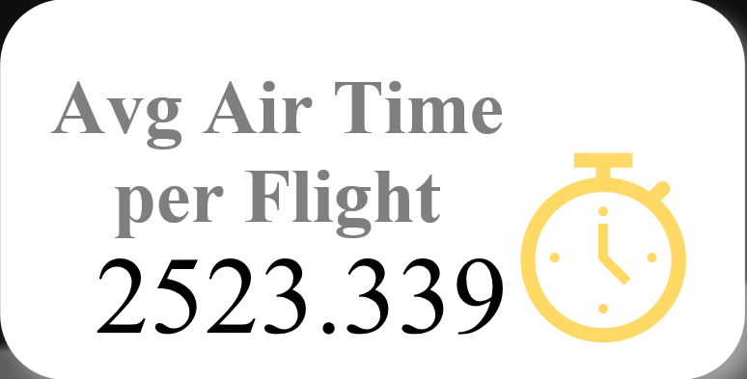
Average Air Time
KPI
Helps evaluate delays, route efficiency, and congestion impact
Key Insights
Average air time for the airlines is 2,523 minutes
Helps compare route efficiency and operational consistency

Slide 8
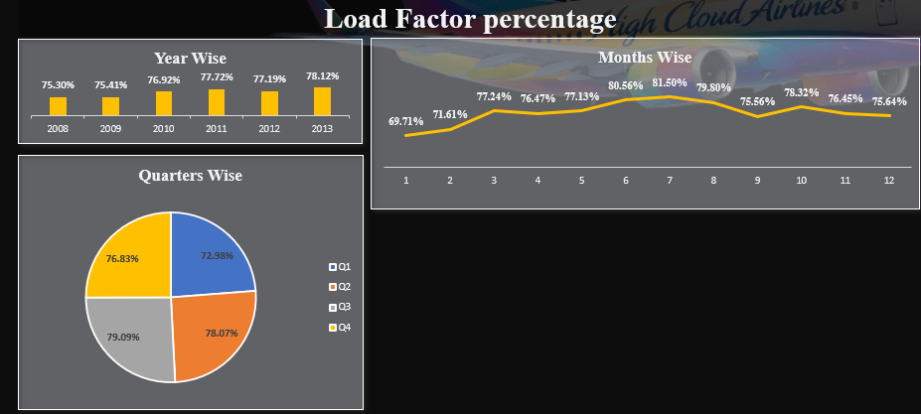
Load Factor % on a Yearly, Quarterly & Monthly basis
Chart and Key Insights
Variation in seat utilization across months, quarters and years.
Captures seasonality patterns
Identifies peak and off-peak travel periods
Peak load factor during mid-year months
Lower utilization in early and late months
Q3 shows highest utilization
Suggests summer and holiday travel demand
Upward trend from 2007 to 2014
Demonstrates better capacity and demand management over year

Slide 9
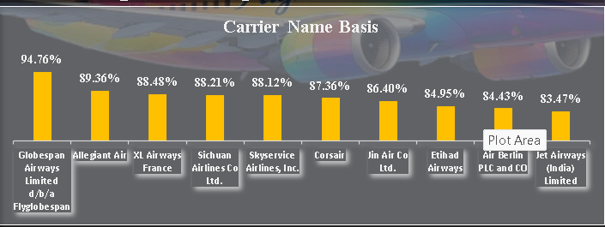
Load Factor % based on Carrier Name
Chart
Seat utilization efficiency across airlines.
Enables competitive benchmarking
Identifies best-performing and underperforming carriers
Key Insights
Globespan Airways leads with ~95% utilization
Shows strong route efficiency and demand alignment

Slide 10
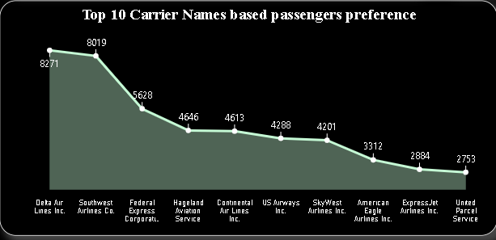
Top 10 Carrier Names based on Passenger’s Preference
Chart and Key Insight
Ranking airlines by passenger volume.
Delta Airlines and Southwest Airlines lead in passenger preference.
Useful for competitive benchmarking.
Shows the passengers preference

Slide 11
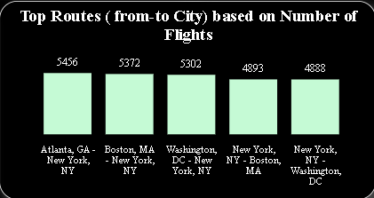
Top Routes (from-to city) based on No. of Flights
Chart and Key Insights
Visualizes busiest routes by flight count.
Atlanta – New York (5456) and Boston – New York(5372) are the busiest routes by flight count
Helps airlines prioritize capacity and optimize high-demand routes.

Slide 12
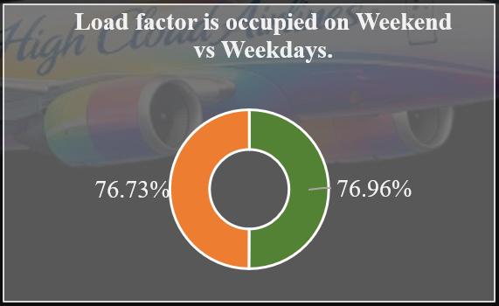
Load Factor on Weekend vs Weekday
Chart and Key Insights
Comparison of passenger utilization based on travel days.
Helps understand business vs leisure travel patterns
Useful for scheduling and pricing
Almost equal distribution between weekday and weekend
Indicates balanced travel demand

Slide 13
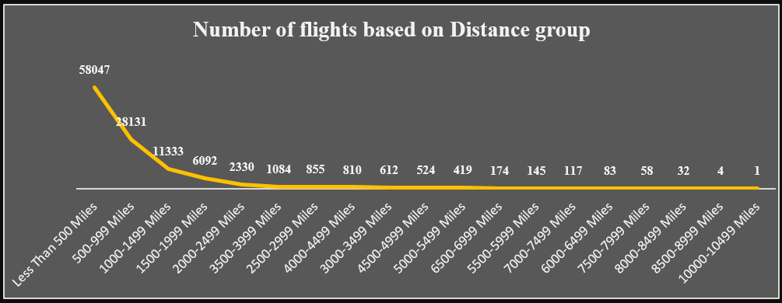
No. of Flights based on Distance Group
Chart and Key Insights
Shows flight distribution by distance.
Majority of flights fall under short-haul categories (<1000 miles).
Flight count sharply decreases as distance increases.

Slide 14
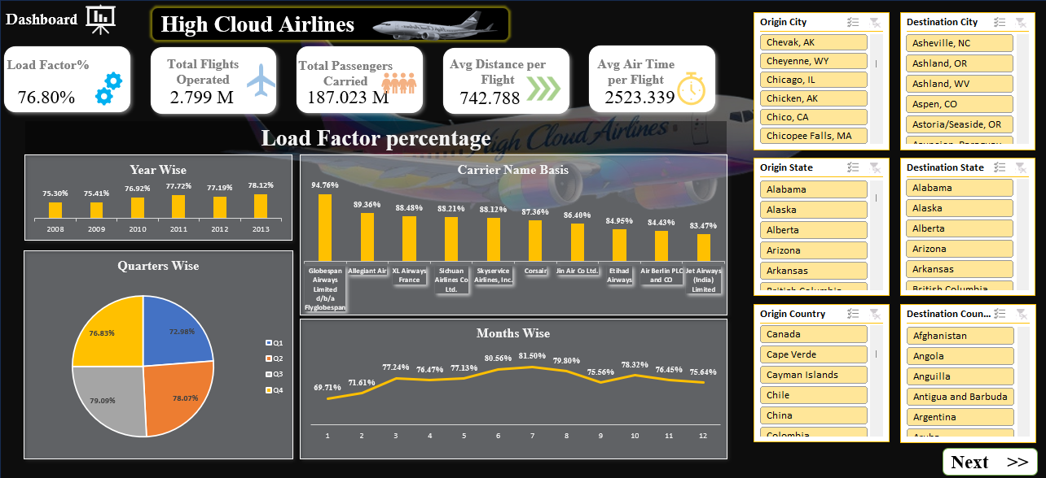
EXCEL DASHBOARD

Slide 15
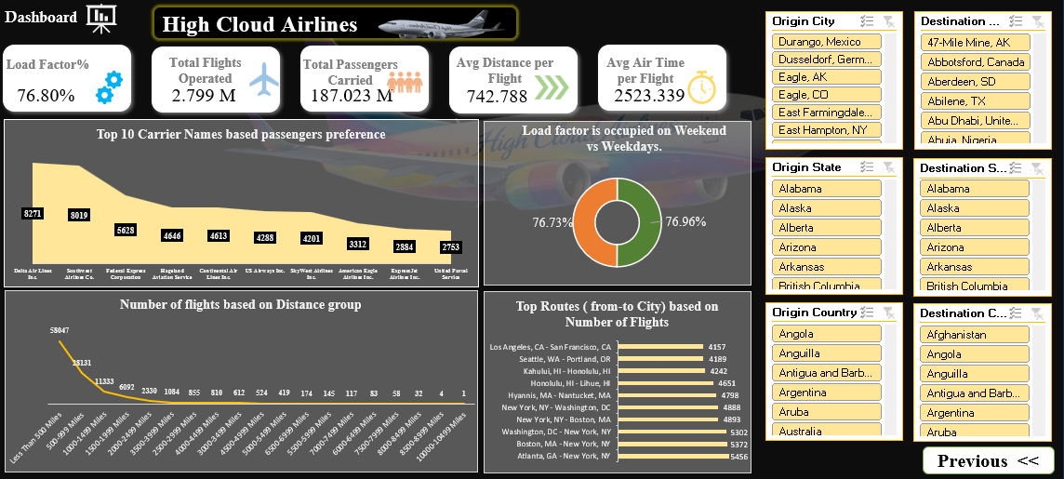

Slide 16
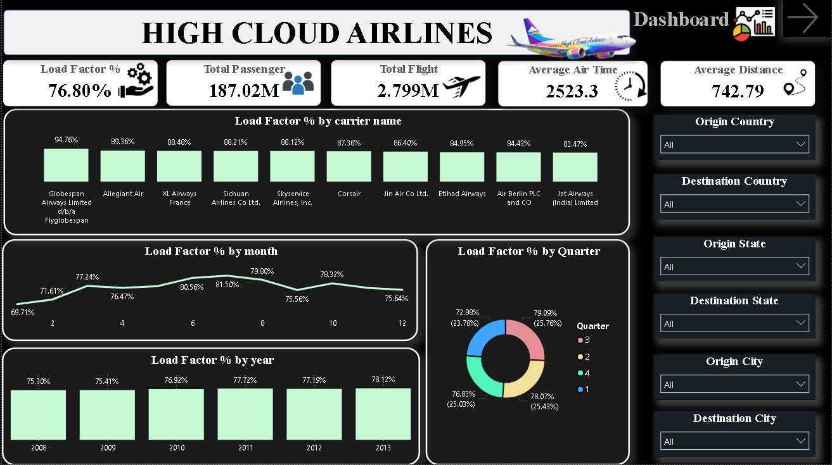
POWER BI DASHBOARD

Slide 17
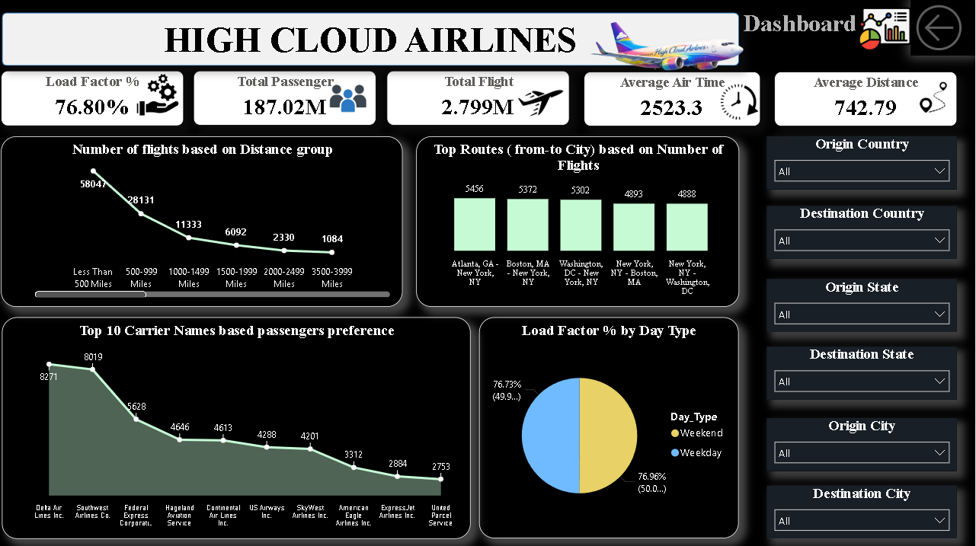

Slide 18
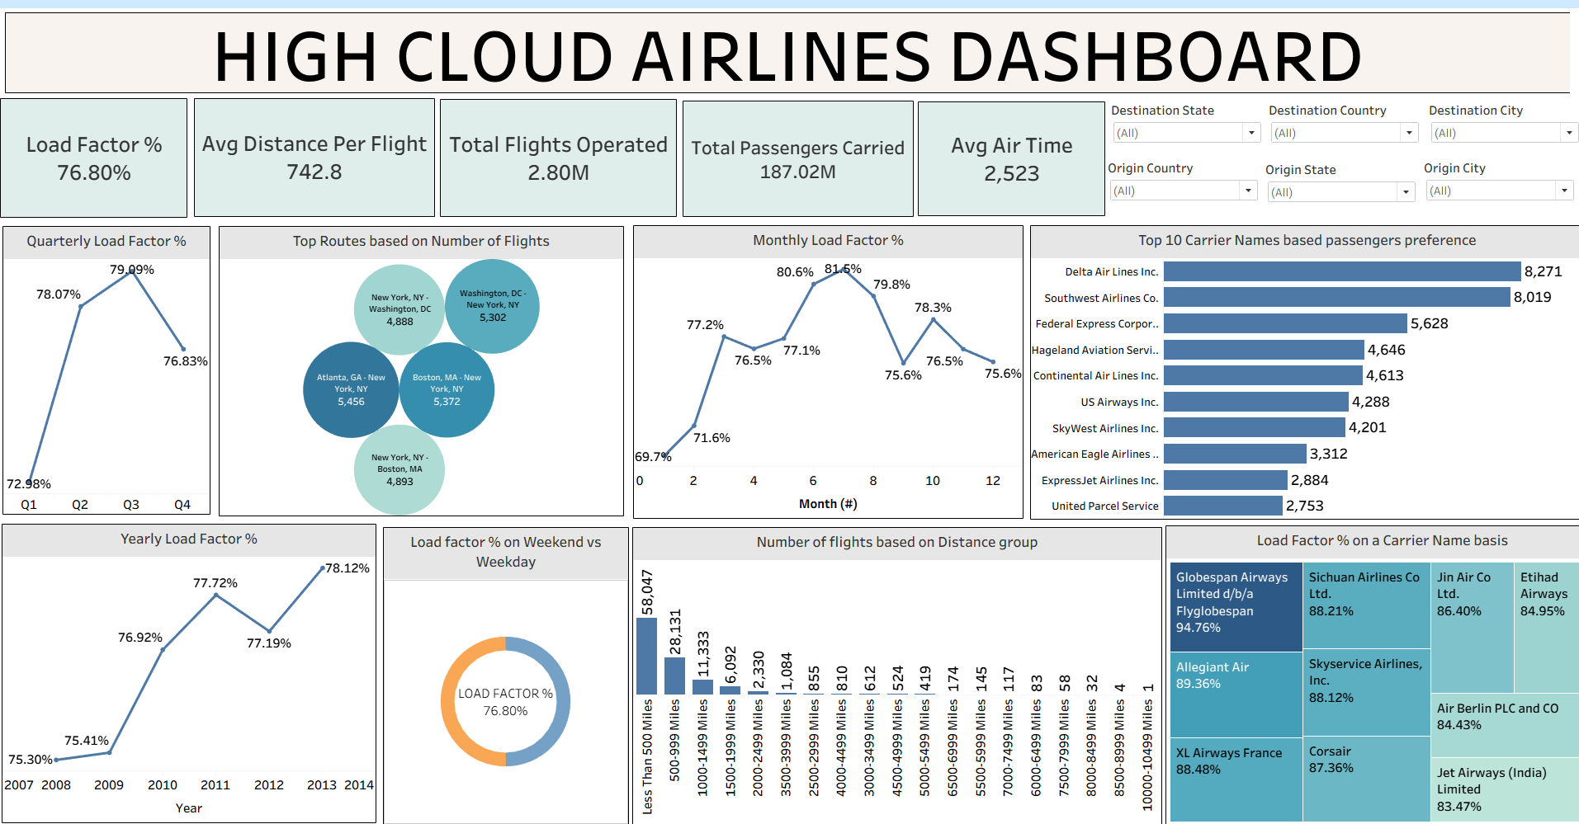
TABLEAU DASHBOARD

Slide 19
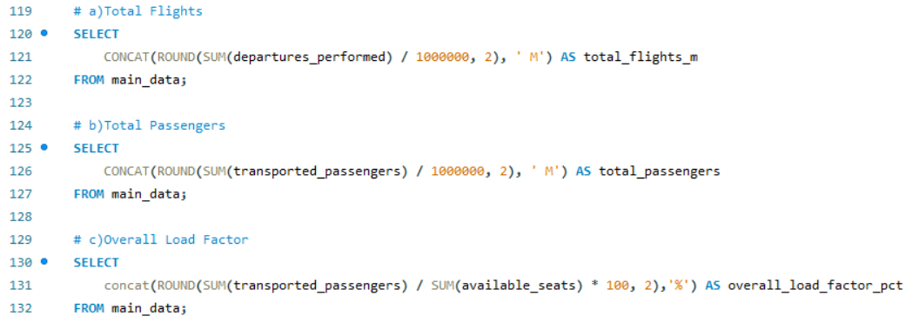
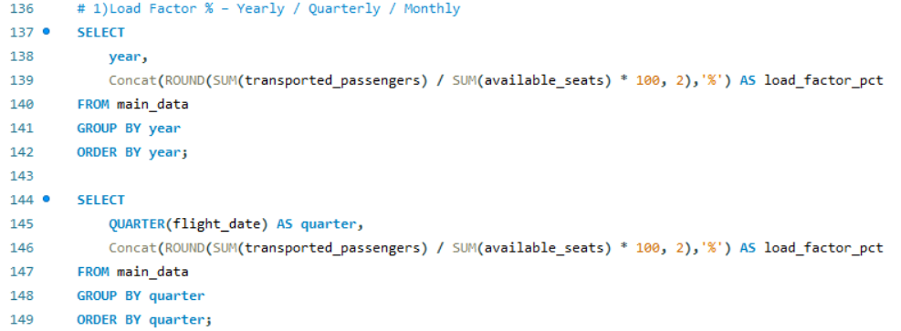
SQL QUERIES

Slide 20
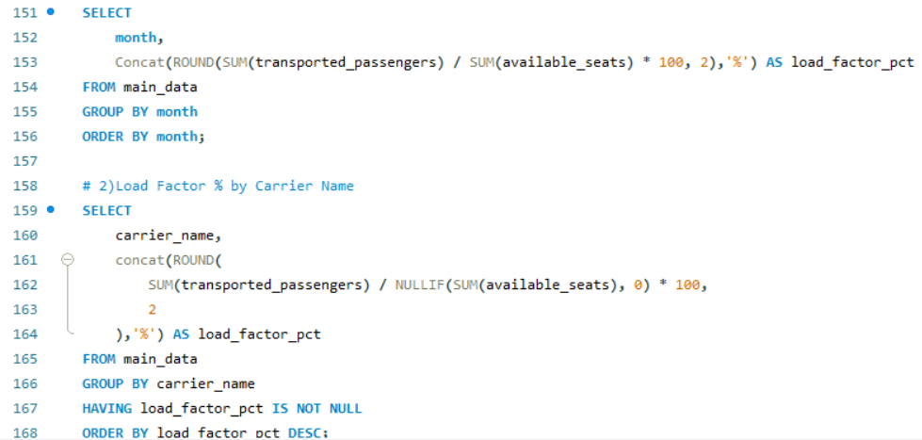
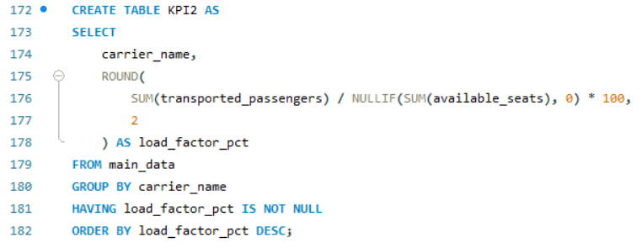

Slide 21
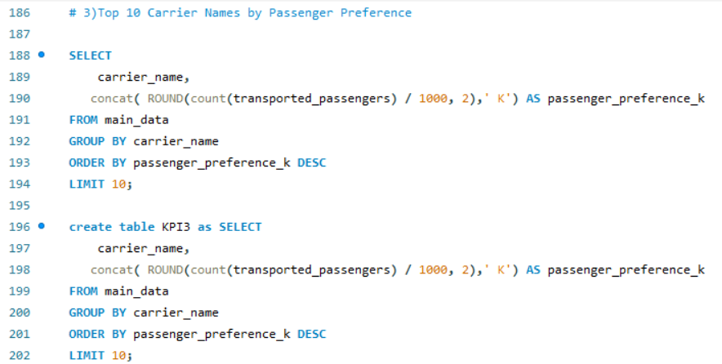
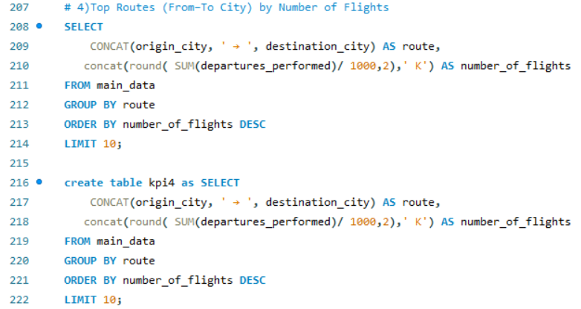

Slide 22
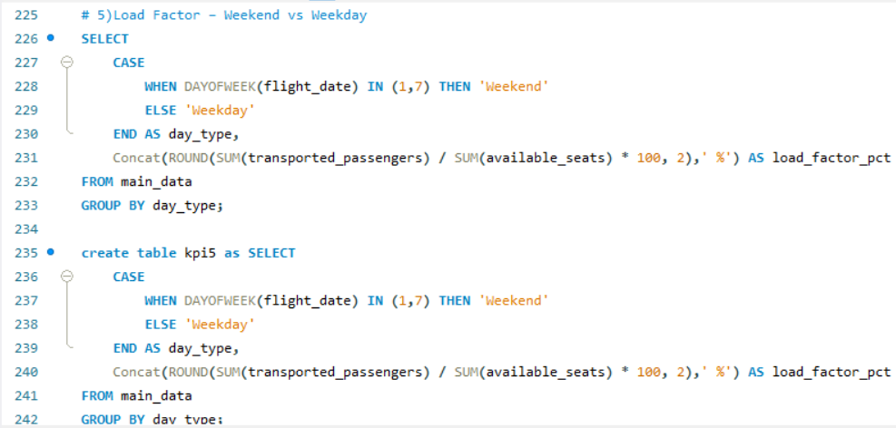

Slide 23
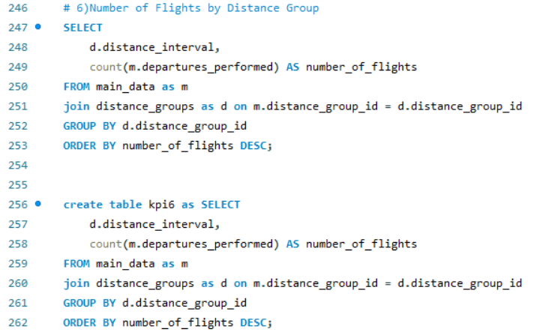

Slide 24

KEY INSIGHTS
Overall performance is strong and stable with an average Load Factor of 76.8%, indicating efficient seat utilization across the network.
Passenger demand shows clear seasonality:
Load factor peaks mid-year (around Q3 and months 6–7, ~81–82%), suggesting strong summer demand.
Lower utilization appears in early months and Q4, highlighting off-peak periods.
High-volume routes dominate operations, especially major city pairs like Washington DC–New York, Boston–New York, and Atlanta–New York, confirming a hub-centric network strategy.
Short and medium-haul flights contribute most to total flight counts, while long-haul routes are fewer but likely higher in revenue impact.
Carrier-wise insights show imbalance
Some carriers achieve very high load factors, indicating strong pricing, demand alignment, or route optimization.
Others lag behind despite high passenger volumes, signaling potential inefficiencies.
Weekend vs weekday load factor remains similar, implying consistent demand throughout the week rather than leisure-only spikes.

Slide 25
Introduce dynamic pricing, targeted promotions, or bundled offers during low-load months (early year & Q4).
Short-haul routes: focus on cost efficiency and high-frequency operations.
1
2
RECOMMEDATIONS
Re-evaluate partnerships or route assignments for consistently underperforming carriers.
Increase capacity or deploy larger aircraft on top-performing routes during peak seasons.
3
4

Slide 26
CHALLENGES & SOLUTIONS
CHALLENGE
The airline dataset was very large and complex, making analysis and performance optimization difficult.
SOLUTIONS
Optimized data model by using aggregations and calculated measures instead of row-level visuals.
Apply filters and slicers to allow fast and focused analysis without overloading visuals.
CHALLENGE
Analysing how many flights cover a short range of distance and long range of distance was difficult as
it was not straightforward.
SOLUTIONS
Grouped flights into distance buckets for better analysis.
Using a chart for flights and distance buckets to show that the short and medium haul flights dominate.
CHALLENGE
Analysing too many routes made it hard to quickly identify high-impact city pairs.
SOLUTIONS
Focusing only on the Top routes by number of flights using a filter.
Highlighting the top routes.
CHALLENGE
Difficult for all the members to communicate with each other and to work simultaneously because
of everyone’s busy schedule.
SOLUTIONS
Connected through zoom calls for better understanding.
Helped each other if the person is super busy.

Slide 27


